Slide 1
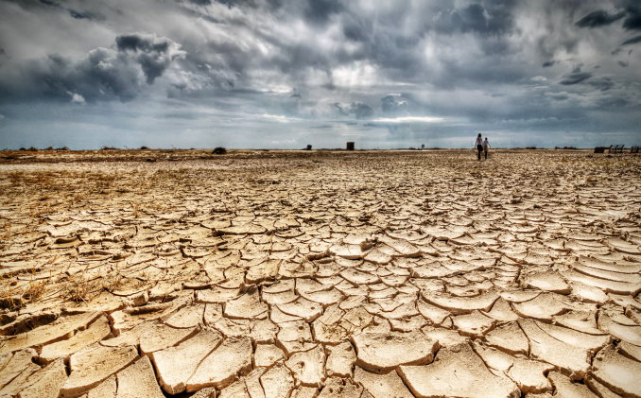
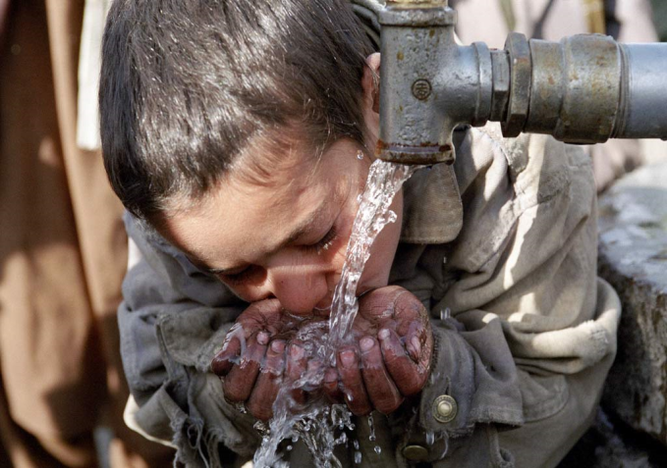
Water Stress
Environmental Issue
Headlines:-
Description of the problem
Water stressed regions
The effects of water shortage
Solutions

Slide 2
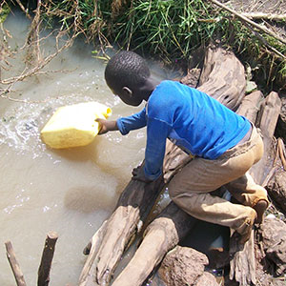
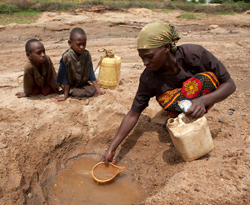
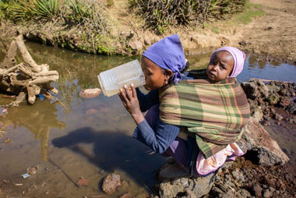
Water Stress
The Definition of Water Stress
1.2 Billion

Slide 3
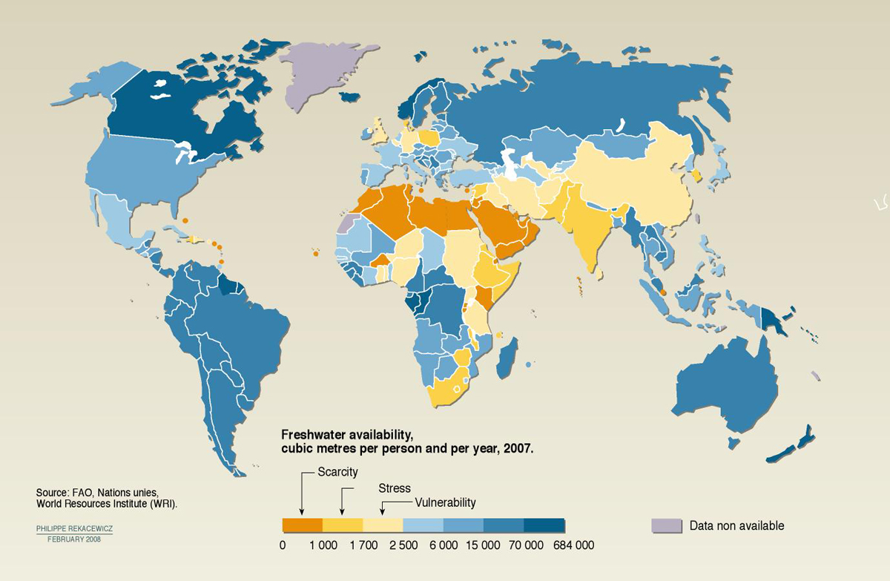
Water Stressed Regions
2.8 billion people in 48 countries will face water stress.
Egypt, Kuwait, United Arab Emirates, Libya, Yemen, Oman, and Saudi Arabia.
China and India are using more than 80 percent of their renewable water resources
run short of water in the next 25 years: Ethiopia, India, Kenya, Nigeria and Peru.

Slide 4
The Effects of Water Shortage
Health (low quality, diseases)
Hunger (growing food, care for animals)
Education (children collect water for the family)
Poverty (no economic activities )

Slide 5
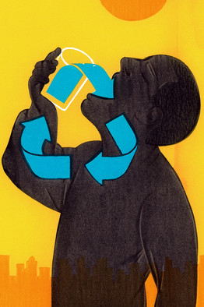
Solutions
Educate to change consumption and lifestyles
Recycle wastewater
Population growth control

Slide 6

Thank you for listening
Any questions ?
Made by Wisam Siyamak

